Slide 1
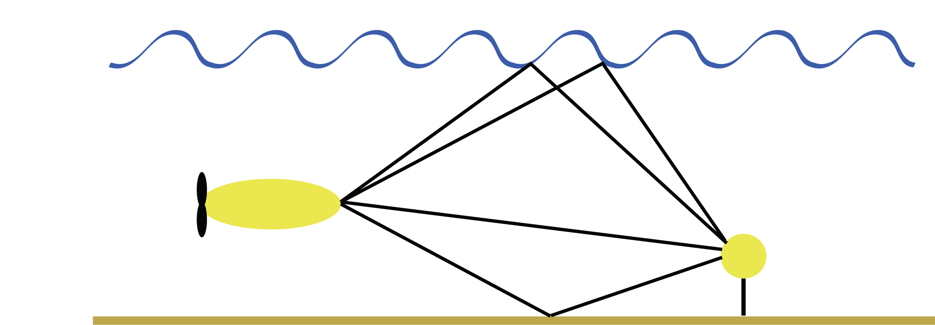
Comparison and Analysis of Equalization Techniques for the Time-Varying Underwater Acoustic Channel
Ballard Blair
bjblair@mit.edu
PhD Candidate
MIT/WHOI Joint Program
Advisor: Jim Presisig
158th Meeting of the Acoustical Society of America
San Antonio

Slide 2
Channel Model
Baseband noise
Transmitted Data
+
Baseband Received Data
Time-varying, linear baseband channel
Matrix-vector Form:
Split Channel Convolution Matrix

Slide 3
Decision Feedback Equalizer (DFE)
Problem Setup:
Estimate using RX data and TX data estimates
DFE Eq:
Two Parts:
(Linear) feed-forward filter (of RX data)
(Linear) feedback filter (of data estimates)
Solution to Weiner-Hopf Eq.
MMSE Sol. Using Channel Model

Slide 4
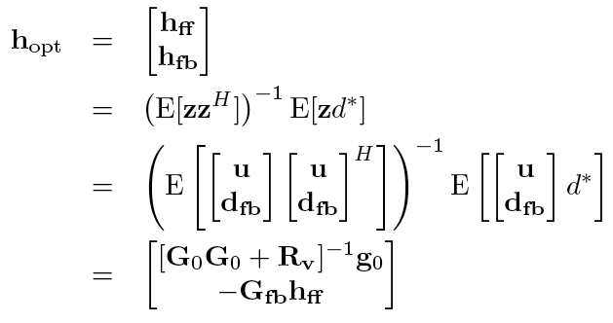
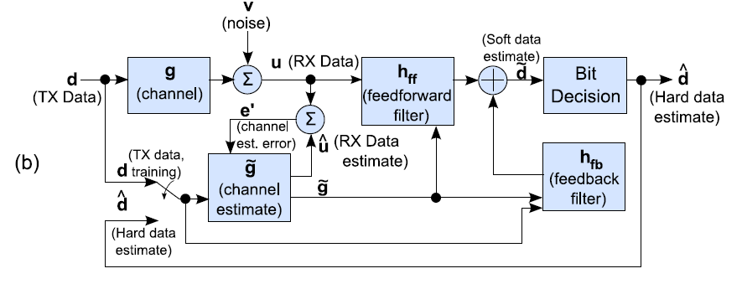
DFE Strategies
Direct Adaptation:
Equalizer Tap Solution:
Channel Estimate Based (MMSE):

Slide 5
Central Question:
Why is the performance of a channel estimate based equalizer different than a direct adaptation equalizer?

Slide 6
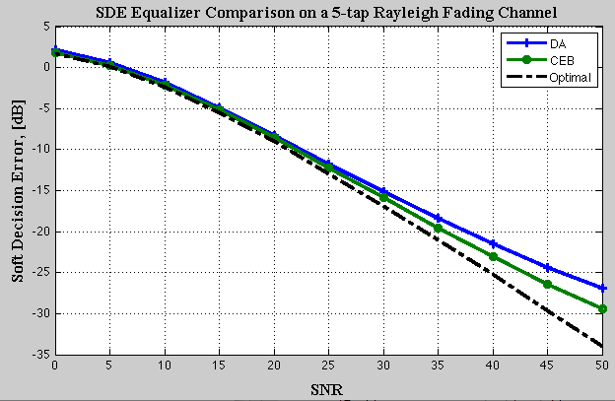
Comparison between DA and CEB
In the past, CEB methods empirically shown to have lower mean squared error at high SNR
Reasons for difference varied:
Condition number of correlation matrix
Num. of samples required to get good estimate
Similar performance at low SNR
3dB performance difference between CEB and DA at high SNR
Performance gap due to channel estimation

Slide 7
Comparison between DA and CEB
Our analysis shows the answer is: Longer corr. time for channel coefficients than MMSE equalizer coefficients at high SNR
Will examine low SNR and high SNR regimes
Use simulation to show transition of correlation time for the equalizer coefficients from low to high is smooth

Slide 8
Low SNR Regime
Update eqn. for feed-forward equalizer coefficients (AR model assumed):
Approximation:
Has same correlation structure as channel coefficients

Slide 9
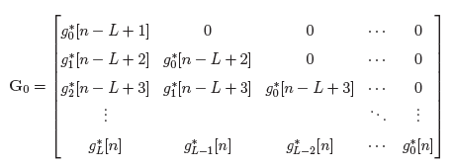
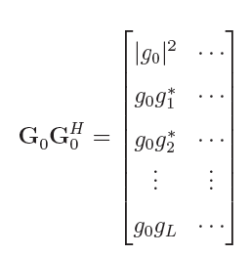
High SNR
Approximation:
Reduced Channel Convolution Matrix:
Matrix Product:
Reduces to single tap:

Slide 10
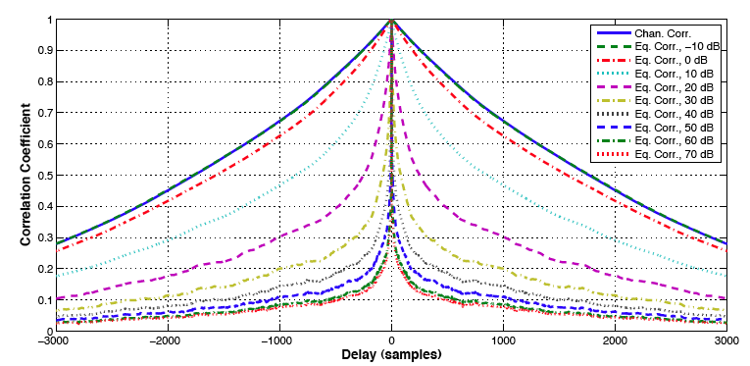
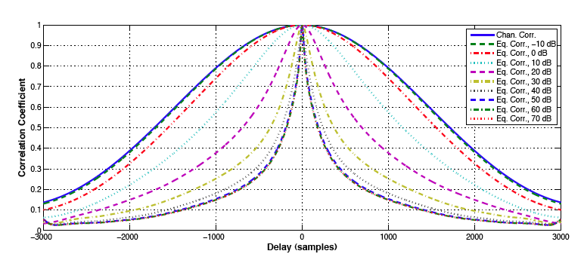
Correlation over SNR – 1-tap
Channel and Equalizer Coeff. Correlation the Same at low SNR
AR(1)model
Equalizer Coeff. Correlation reduces as SNR increases
Gaussian model

Slide 11
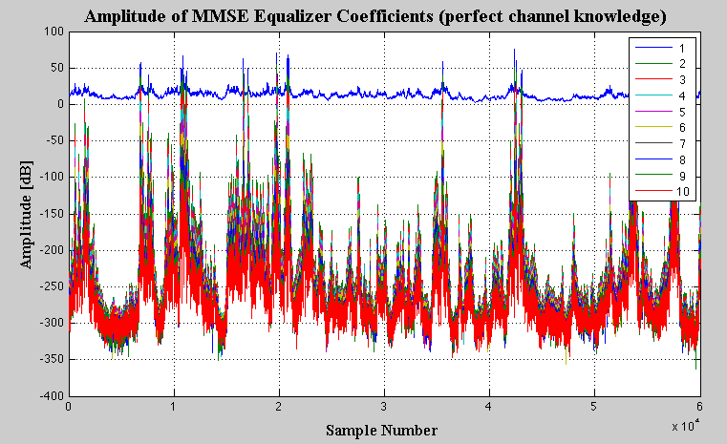
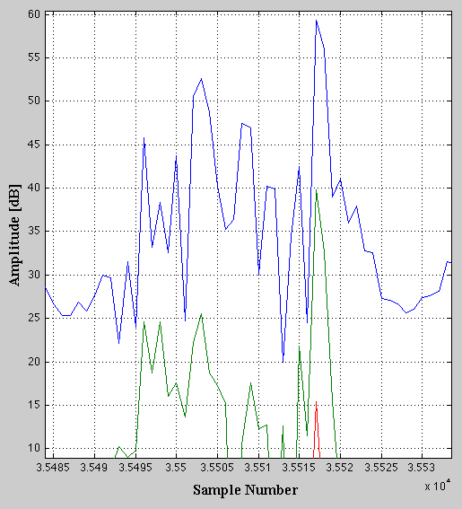
Amplitude of MMSE Eq. Coeff.
Tap #
20 dB difference
First feed-forward equalizer coefficient has much larger amplitude than others

Slide 12
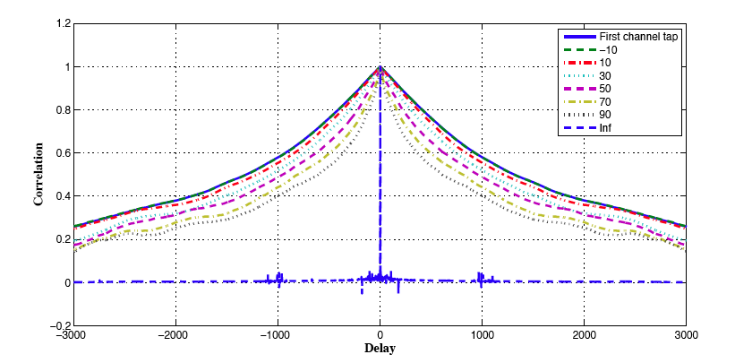
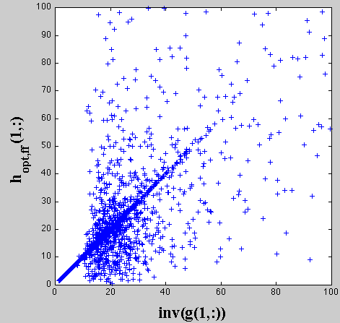
Multi-tap correlation
SNR
Multi-tap
AR(1)model
Strong linear correlation between inverse of first channel tap and first MMSE Eq. tap

Slide 13
Take-home Message
Channel impulse-response taps have longer correlation time than MMSE equalizer taps
DA has greater MSE than CEB
For time-invariant statistics, CEB and DA algorithms have similar performance
Low-SNR regime (assuming stationary noise)
Underwater channel operates in low SNR regime (<35dB)

Slide 14
Questions?

Slide 15
Backup Slides

Slide 16
Assumptions
Unit variance, white transmit data
TX data and obs. noise are uncorrelated
Obs. Noise variance:
Perfect data estimation (for feedback)
Equalizer Length = Estimated Channel Length
N_{a} + N_{c} = L_{a} + L_{c}
MMSE Equalizer Coefficients have form:

Slide 17
WSSUS AR channel model
Simple channel model to analyze
Similar to encountered situations

Slide 18
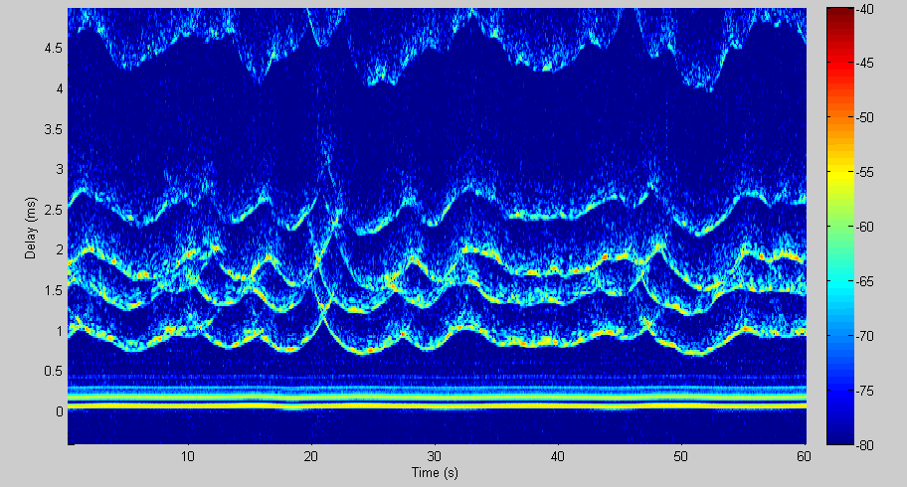
Time Varying Impulse Response
Wave interacting paths, highly
Direct Path and Bottom Bounce, Time Invariant
Wavefronts II Experiment from San Diego, CA

Slide 19
Future Work
Reduce time needed to update channel model
Sparsity
Physical Constraints
Optimization Techniques
Combine DA and CEB equalizers
Better performance at lower complexity

