Slide 1
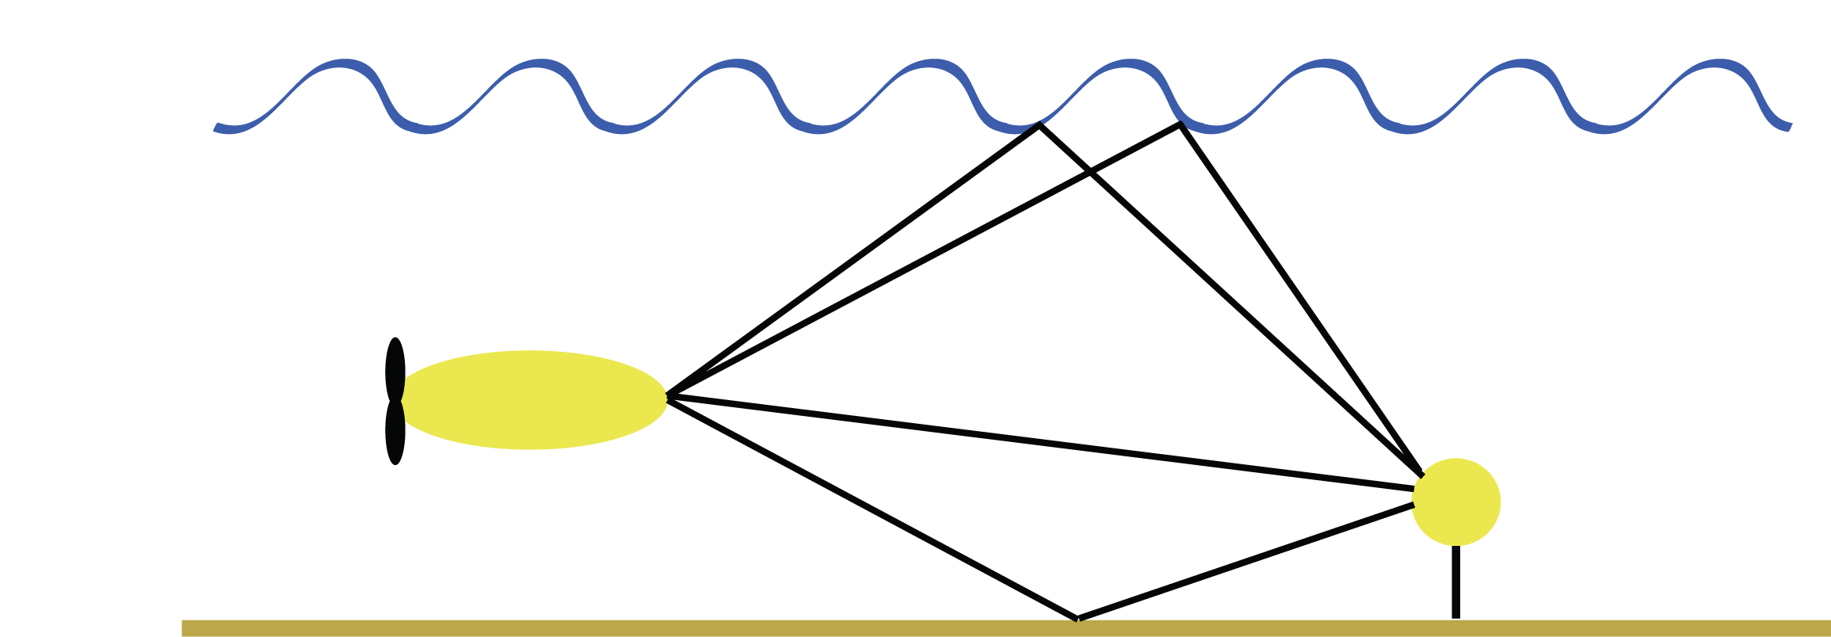


Communicating through the Ocean: Introduction and Challenges
Ballard Blair
bjblair@mit.edu
PhD Candidate
MIT/WHOI Joint Program
Advisor: Jim Presisig

Slide 2
Background
BS in Electrical and Computer Engineering, Cornell university 2002
MS in Electrical and Computer Engineering, Johns Hopkins 2005
Hardware Engineer, JHUAPL 2002-2005
PhD Candidate, MIT/WHOI Joint Program

Slide 3
Goals of Talk
Motivate need for wireless underwater communication research
Introduce difficulties of underwater acoustic communications
Discuss current methods for handling underwater channel

Slide 4
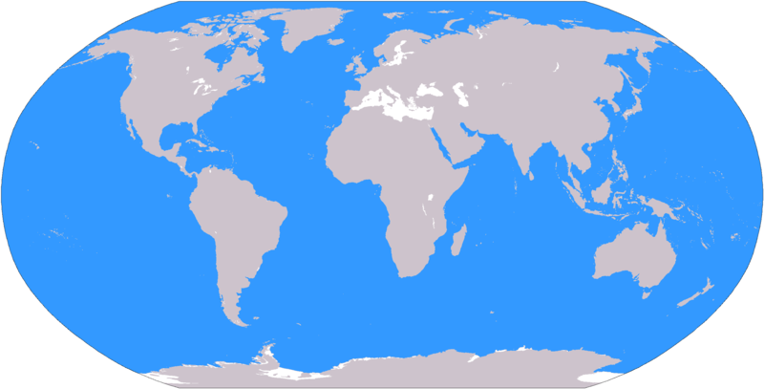
Introduction and Motivation
Ocean covers over 70% of planet
11,000 meters at deepest point
Ocean is 3-dimensional
Only 2-3% explored
Notes:
More water than land
The ocean is three dimensional
Sparsely populated
Only 2-3% explored

Slide 5
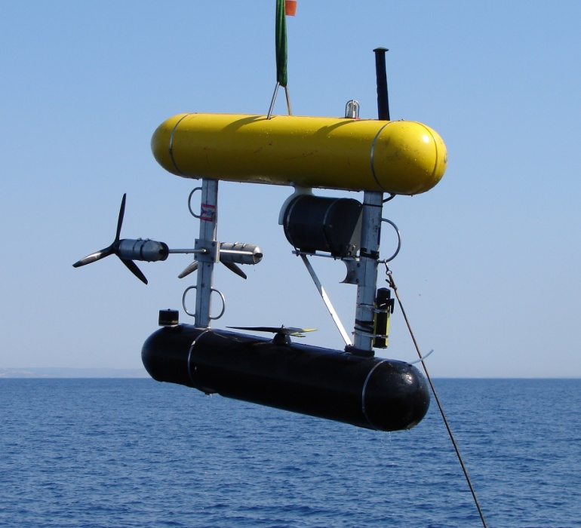
Communications in the ocean
Instruments / Sensor networks
Gliders
Manned Vehicles
Unmanned underwater vehicles (UUV)
  Autonomous underwater vehicles (AUV)
  Remotely operated vehicles (ROV)
  Hybrid underwater vehicles (H-AUV / H-ROV)
Notes:
Recent boom in underwater vehicle technology
As vehicles become cheaper / more accessible, more applications arise
WHOI headed to look for lost data flight recorder using AUVs

Slide 6
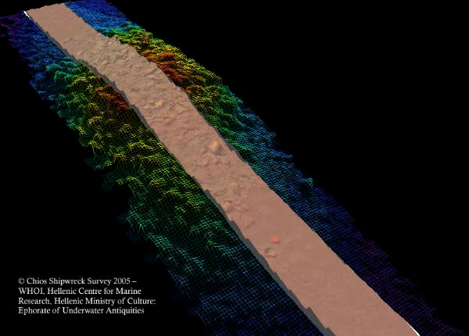
Current Applications
Science
  Geological / bathymetric surveys
  Underwater archeology
  Ocean current measurement
  Deep ocean exploration
Government
  Fish population management
  Costal inspection
  Harbor safety
Industry
  Oil field discovery/maintenance
WHOI, 2005

Slide 7
Applications planned / in development
Ocean observation system
  Costal observation
Military
  Submarine communications (covert)
  Ship inspection
Networking
  Mobile sensor networks (DARPA)
Vehicle deployment
  Multiple vehicles deployed simultaneously
  Resource sharing among vehicles

Slide 8
Technology for communication
Radio Frequency (~1m range)
  Absorbed by seawater
Light (~100m range)
  Hard to aim/control
  High attenuation except for blue/green
  Strong dependence on water clarity
Ultra Low Frequency (~100 km)
  Massive antennas (miles long)
  Very narrowband (~50 Hz)
  Not practical outside of navy
Cable
  Expensive/hard to deploy maintain
  Impractical for mobile work sites
  Ocean is too large to run cables everywhere
  Can’t run more than one cable from a ship
?

Slide 9
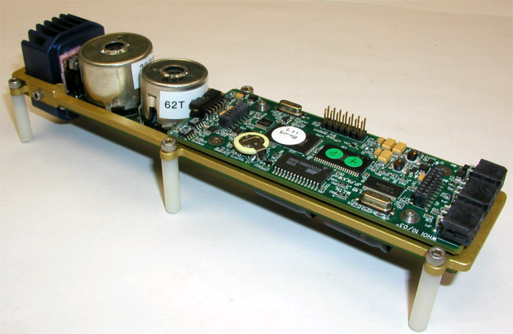
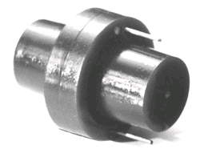
The Solution: Acoustics
Fairly low power
  ~10-100W Tx
  ~100 mW Rx
Well studied
  Cold war military funding
Compact
  Small amount of hardware needed
Current Best Solution
WHOI Micromodem

Slide 10
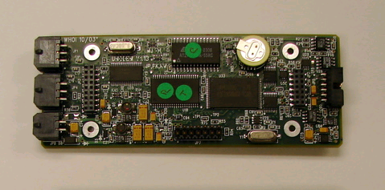
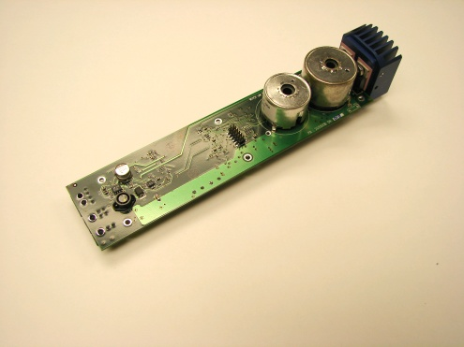
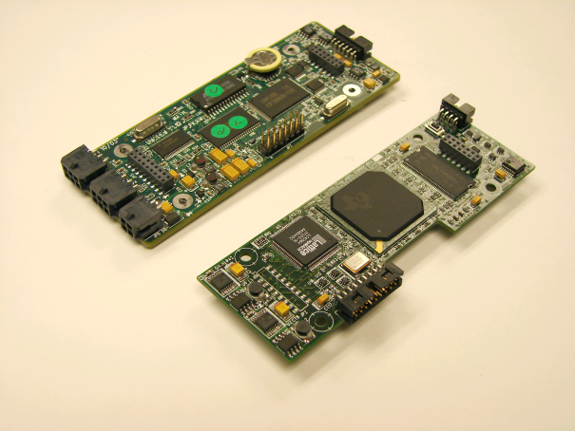
Example Hardware
Power Amp
WHOI Micromodem
Micromodem in action
Micromodem Specifications
DSP | Texas Instruments TMS320C5416 100MHz low-power fixed point processor
Transmit Power | 10 Watts Typical match to single omni-directional ceramic transducer.
Receive Power | 80 milliwatts While detecting or decoding an low rate FSK packet.
Data Rate | 80-5400 bps 5 packet types supported. Data rates higher than 80bps FSK require additional co-processor card to be received.
Daughter Card / Co-processor

Slide 11
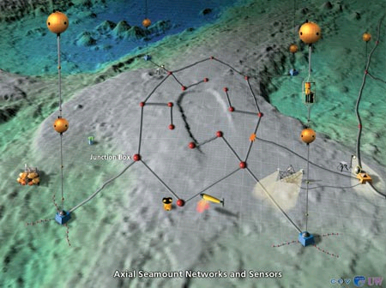
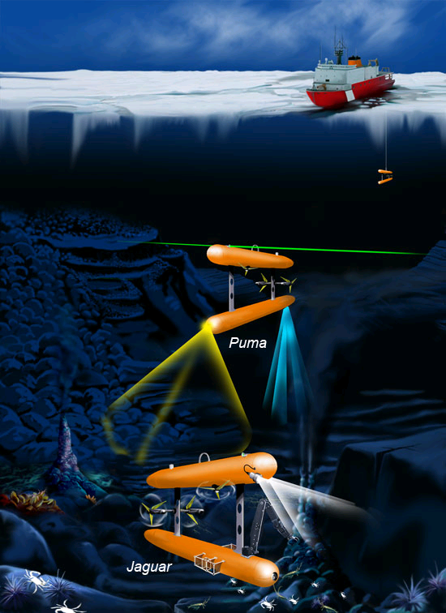
Underwater Technology
NEPTUNE Regional Observatory
WHOI, 2006
Notes:
Wireless communication drives technology
Communication rates are a bottleneck for many applications (also power, reliability)
Size of oceans makes cables impractical

Slide 12
Example Communication System?
PLUSnet/Seaweb

Slide 13
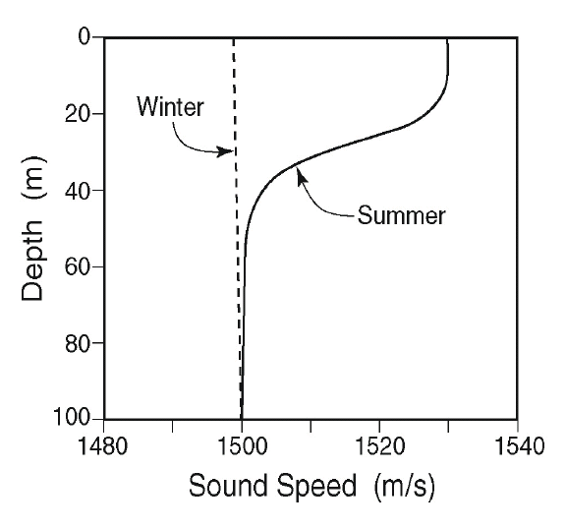
Sound Profile
Speed of sound ~ 1500 m/s
Speed of light ~ 3x10⁸ m/s
Schmidt, Computational Ocean Acoustics
Notes:
Discuss sound channel on this slide.
Note that the sound “prefers” to be in the slower sound speed.

Slide 14
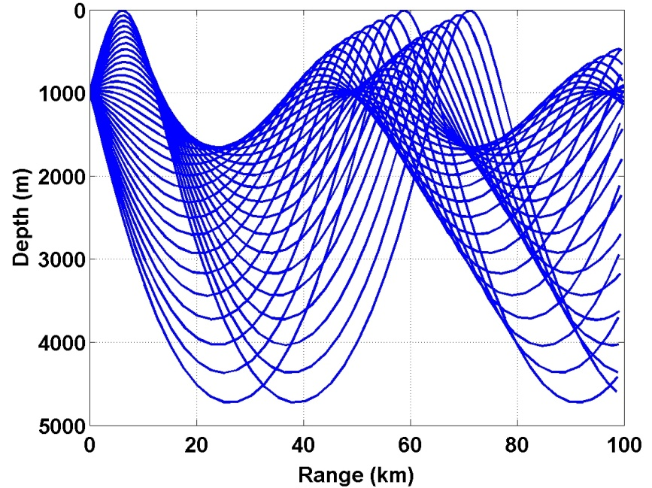
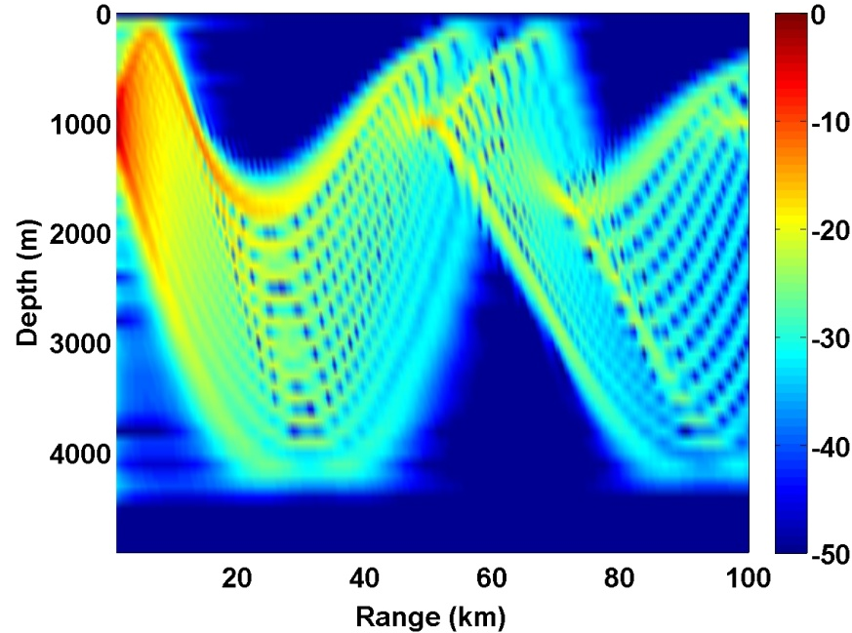
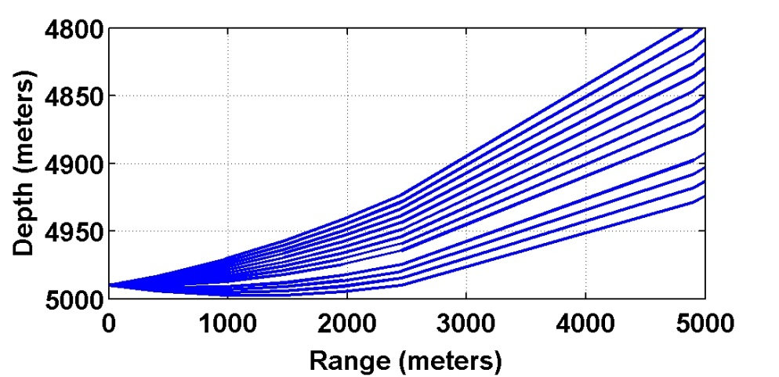
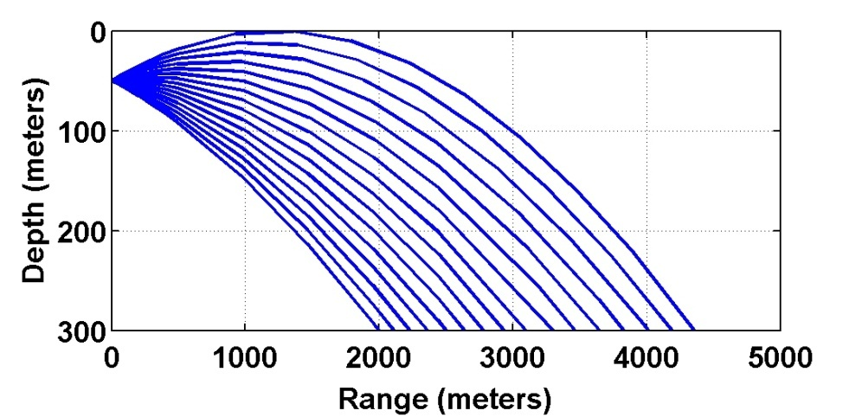
Shadow Zones
Figures from J. Preisig
Notes:
Note the sudden transition from reception to no reception

Slide 15
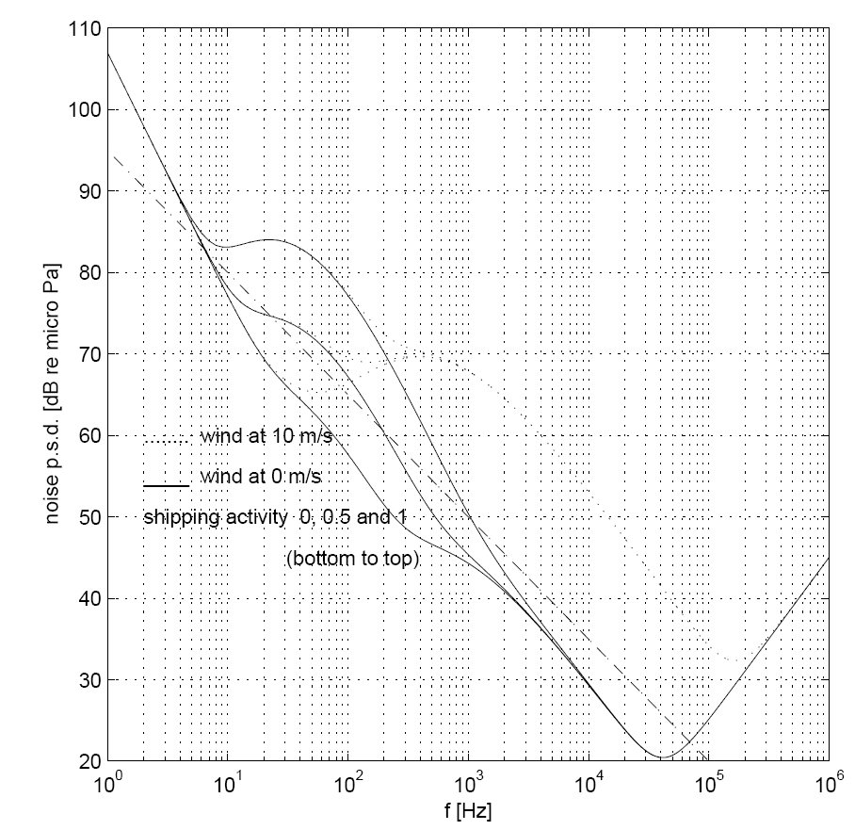
Ambient Noise and Attenuation
Ambient noise
  Passing ships, storms, breaking waves, seismic events, wildlife
Stojanovic, WUWNeT'06
Schmidt, Computational Ocean Acoustics

Slide 16
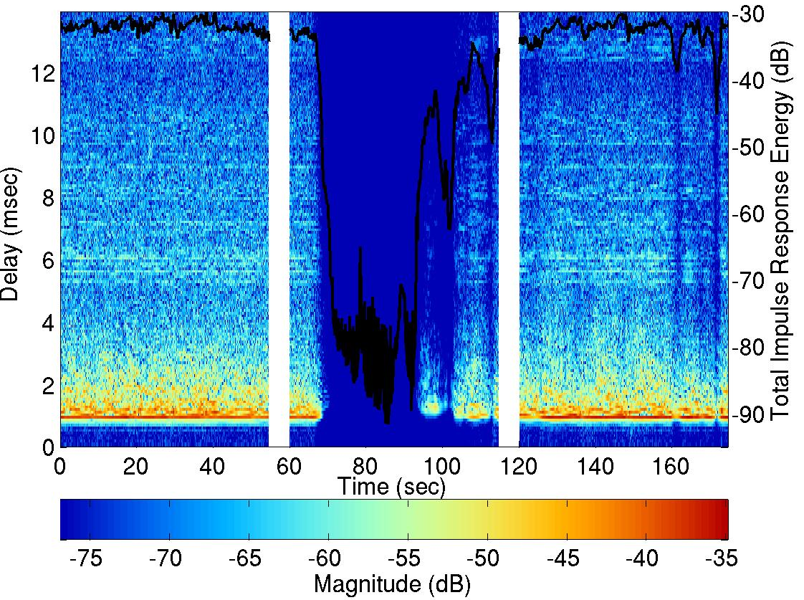
Bubble Cloud Attenuation
Figures from J. Preisig

Slide 17
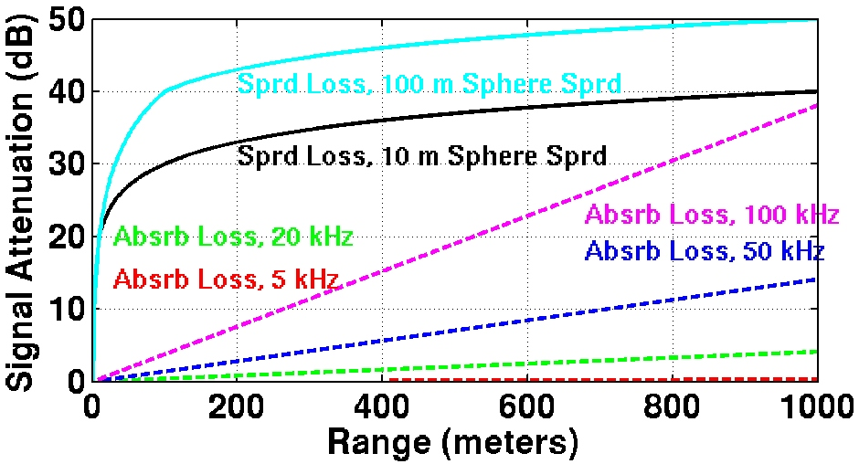
Path loss and Absorption
Path Loss
  Spherical Spreading ~ r ⁻¹
  Cylindrical Spreading ~ r ^{-0.5}
Absorption ~ α(f)^{-r}
  Thorp’s formula (for sea water):
Figure from J. Preisig

Slide 18
Long Range Bandwidth
Source Power: P = 20 Watts
Water depth: h = 500 m
Low modulation frequency
System inherently wide-band
Frequency curtain effect
  Form of covert communications
  Might help with network routing
Figure courtesy of:
Costas Pelekanakis, Milica Stojanovic

Slide 19
Latency and Power
Propagation of sound slower than light
  Feedback might take several second
  Feedback must not be too time sensitive
Most underwater nodes battery powered
  Communications Tx power (~10-100W)
  Retransmissions costly
1.5 km => 2 second round trip

Slide 20
Shallow Water Multipath

Slide 21
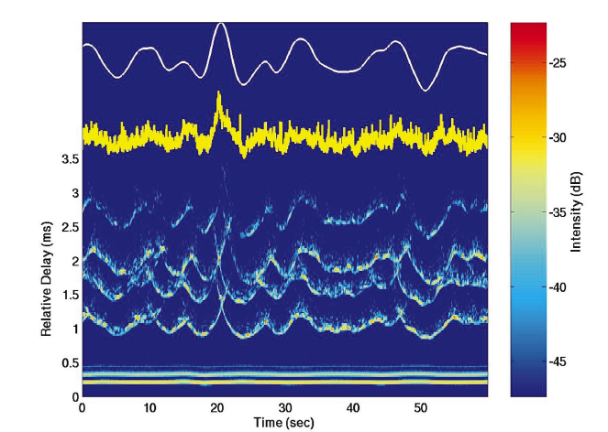
Time Varying Impulse Response
Wave height
Signal Estimation Residual Error
Wave interacting paths, highly time varying
Direct Path and Bottom Bounce, Time Invariant
Wavefronts II Experiment from San Diego, CA
Preisig and Dean, 2004

Slide 22
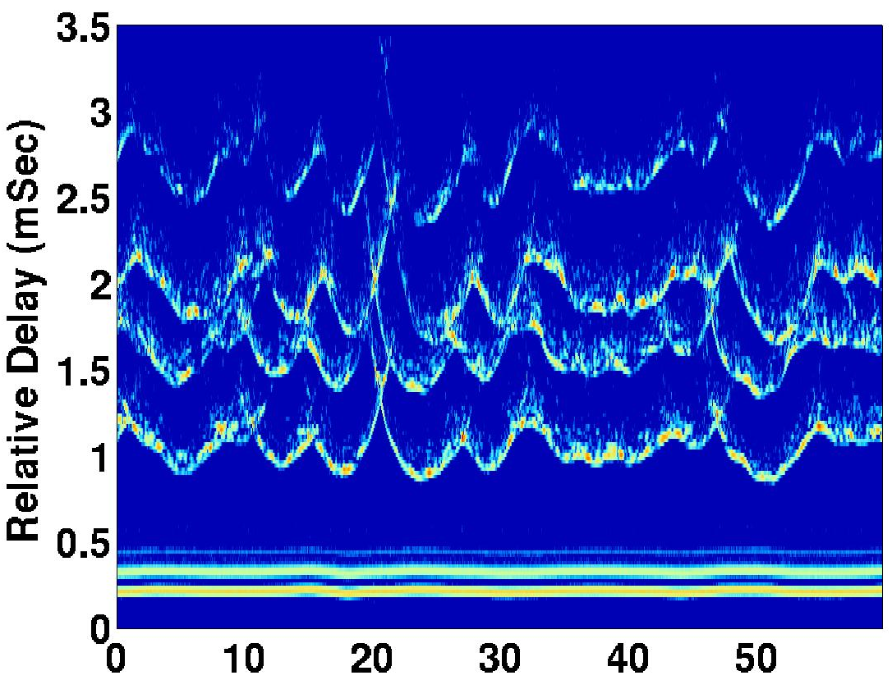
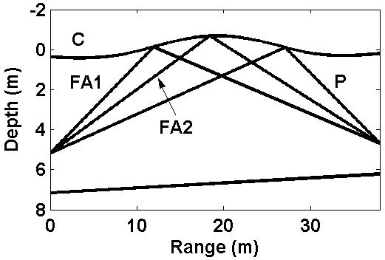
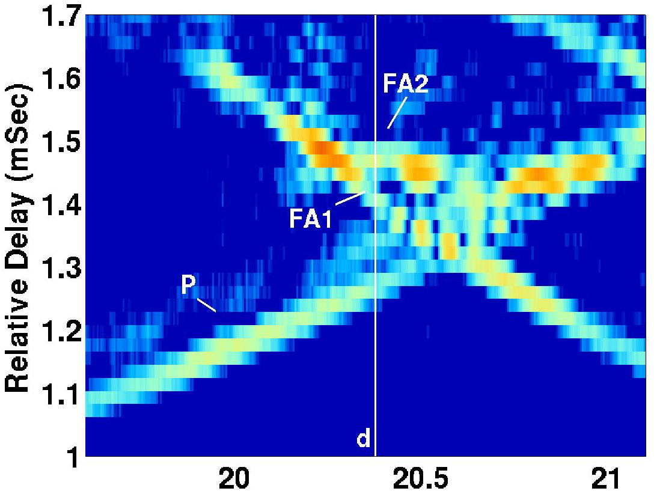
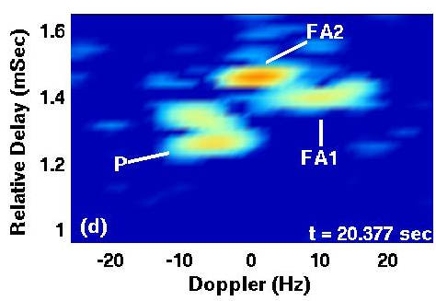
Acoustic Focusing by Surface Waves
Time-Varying Channel Impulse Response
Dynamics of the first surface scattered arrival
Time (seconds)
Preisig, 2006

Slide 23
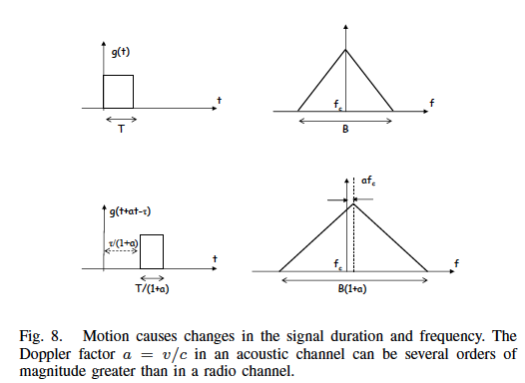
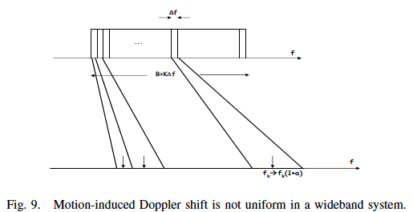
Doppler Shifting / Spreading
Stojanovic, 2008

Slide 24


Bulk Phase Removal
Doppler due to platform motion
TX
RX
Received Data
PLL
(remove bulk phase)
Channel Est. / Equalizer
Transmitted Data estimate

Slide 25
Multipath and Time Variability Implications
Channel tracking and quality prediction is vital
  Equalizer necessary and complex
Coding and interleaving
Network message routing can be challenging

Slide 26




Channel Model
Baseband noise
Transmitted Data
+
Baseband Received Data
Time-varying, linear baseband channel
Matrix-vector Form:
Split Channel Convolution Matrix

Slide 27




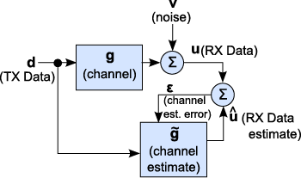
Time-domain Channel Estimation
LMMSE Optimization:
Solution:
Block Diagram:

Slide 28





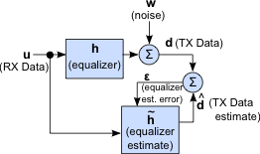
Time-domain Equalization
TX Data bit (linear) estimator:
Vector of RX data and TX data estimates
LMMSE Optimization:
Solution:
Block Diagram (direct adaptation):

Slide 29


Decision Feedback Equalizer (DFE)
Problem Setup:
Estimate using RX data and TX data estimates
DFE Eq:
Two Parts:
  (Linear) feed-forward filter (of RX data)
  (Linear) feedback filter (of data estimates)
Solution to Weiner-Hopf Eq.
MMSE Sol. Using Channel Model

Slide 30
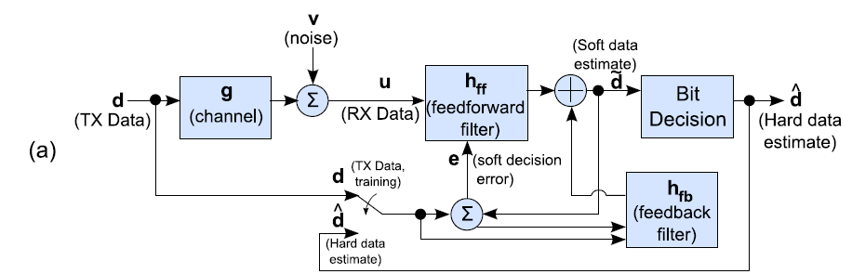
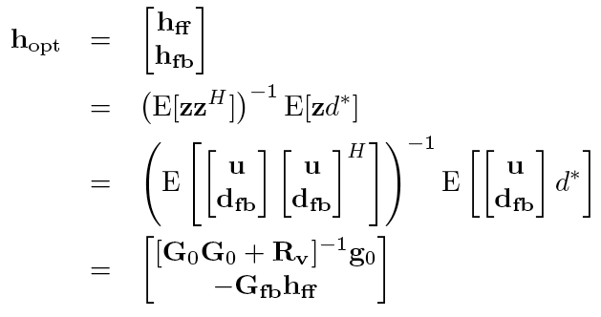
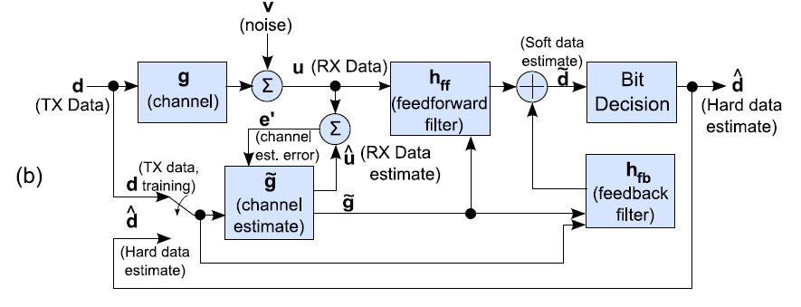
DFE Strategies
Direct Adaptation:
Equalizer Tap Solution:
Channel Estimate Based (MMSE):

Slide 31
Question:
Why is the performance of a channel estimate based equalizer different than a direct adaptation equalizer?

Slide 32
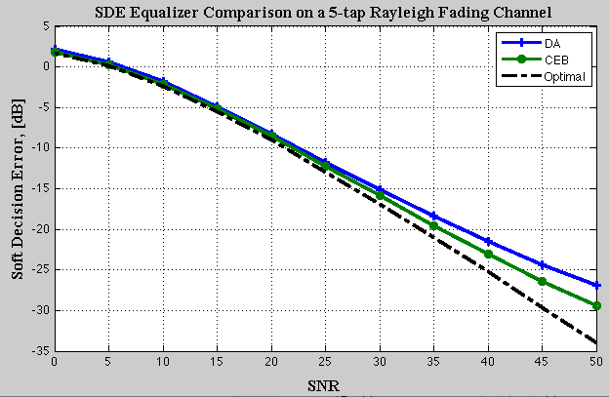
Comparison between DA and CEB
In the past, CEB methods empirically shown to have lower mean squared error at high SNR
Reasons for difference varied:
  Condition number of correlation matrix
  Num. of samples required to get good estimate
Similar performance at low SNR
3dB performance difference between CEB and DA at high SNR
Performance gap due to channel estimation

Slide 33
Comparison between DA and CEB
Our analysis shows the answer is:
Longer corr. time for channel coefficients than MMSE equalizer coefficients at high SNR
Will examine low SNR and high SNR regimes
  Use simulation to show transition of correlation time for the equalizer coefficients from low to high is smooth

Slide 34
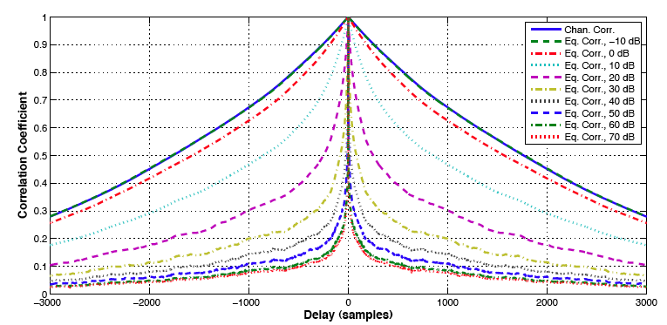
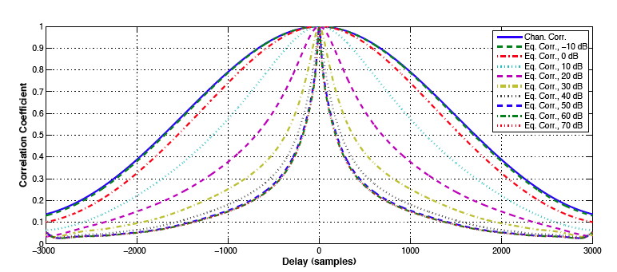
Correlation over SNR – 1-tap
Channel and Equalizer Coeff. Correlation the Same at low SNR
AR(1)model
Equalizer Coeff. Correlation reduces as SNR increases
Gaussian model

Slide 35
Take-home Message
Channel impulse-response taps have longer correlation time than MMSE equalizer taps
  DA has greater MSE than CEB
For time-invariant statistics, CEB and DA algorithms have similar performance
  Low-SNR regime (assuming stationary noise)
  Underwater channel operates in low SNR regime (<35dB)

Slide 36
Question:
How does the structure of the observed noise correlation matrix affect equalization performance?

Slide 37

Recall DFE Equations (again)
DFE Eq:
Vector of data RX data and TX data est.
Assumed noise covariance form:
Solution to Weiner-Hopf Eq.
MMSE Sol. Using Channel Model

Slide 38
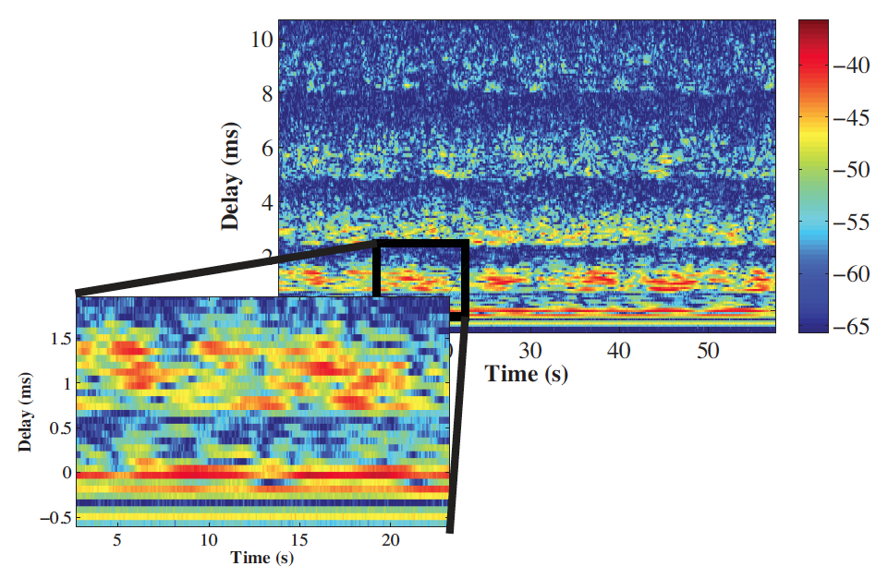
Channel Correlations

Slide 39


Updated Equalizer Equations
Channel Estimation Model:
Effective Noise:
New DFE Eq. Equations:
Effective Noise Term:

Slide 40
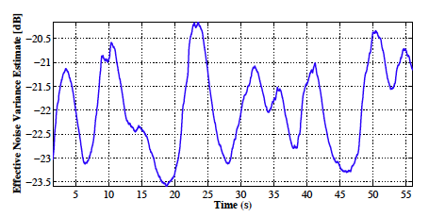
Effective Noise variance from data
SPACE08 Experiment
  Estimate of top-left element of R₀

Slide 41
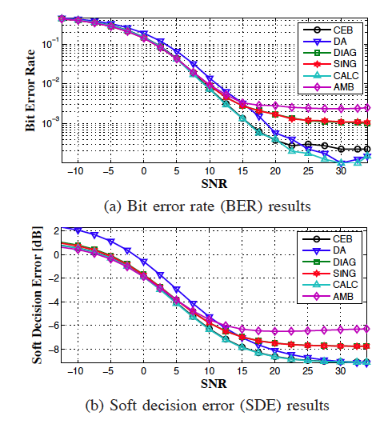
Comparison of Algorithms
SPACE08 Data (training mode)

Slide 42
Take-home message
Diagonal noise correlation matrix is not sufficient for the underwater channel
Need to track noise variance throughout packet
Noise statistics are slowly varying, so can assume matrix is Toeplitz
  Reduces algorithmic complexity

Slide 43
Direct Adaptation Equalization
Does not require (or use) side information
More computationally efficient
  O(N²) vs O(N³)
Model Assumptions

Slide 44
Future Directions and Ideas
Methods to reduce degrees of freedom to be estimated
  Sparsity (very active area right now)
  Physical Constraints
Communication systems do not exist in a vacuum underwater
  Usually on well instrumented platforms
  How can additional information be used to improve communication?

Slide 45
Conclusions
Research in underwater communications is still necessary and active
The underwater channel is challenging
Equalization
  Bulk phase removal through PLL
  DA equalization deserves another look
  Cannot assume diagonal noise correlation matrix

Slide 46
Thanks!
Thanks to Prof. John Buck for inviting me today
For their time and comments:
Jim Preisig
Milica Stojanovic
Project funded by:
The Office of Naval Research

Slide 47

Questions?

Slide 48
Backup Slides

Slide 49
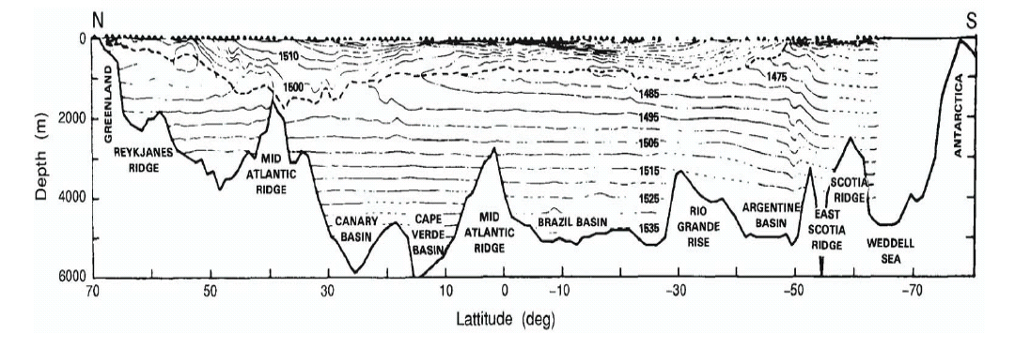
Global Ocean Profile
SOFAR Channel
Schmidt, Computational Ocean Acoustics

Slide 50
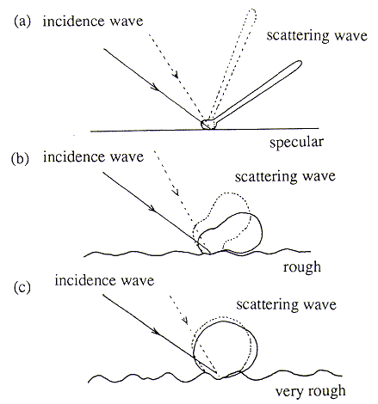
Multipath
Micro-multipath due to rough surfaces
Macro-multipath due to environment
Sea surface
Tx
Rx
seabed

Slide 51
Speed of Sound Implications
Vertical sound speed profile impacts
  the characteristics of the impulse response
  the amount and importance of surface scattering
  the amount of bottom interaction and loss
  the location and level of shadow zones
Horizontal Speed of Sound impacts
  Nonlinearities in channel response

Slide 52
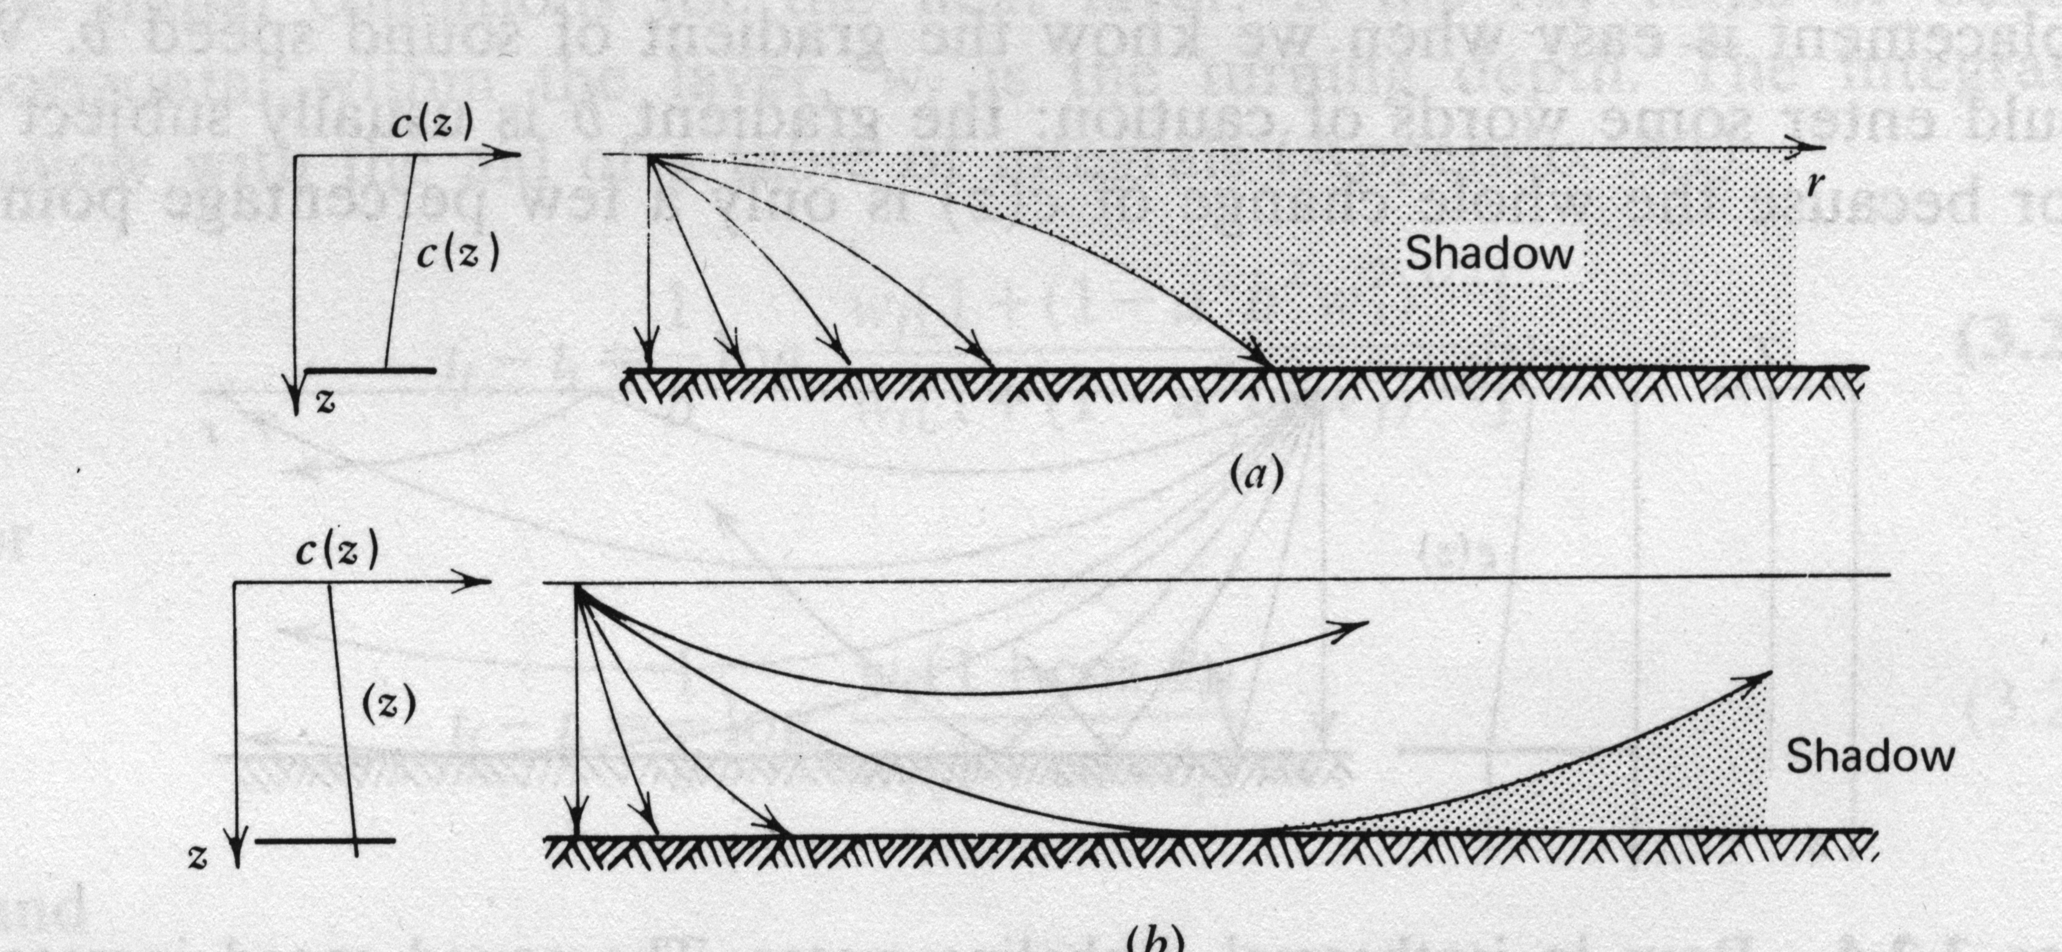
Shadow Zones
Clay and Medwin, “Acoustical Oceanography”
Sometimes there is no direct path (unscattered) propagation between two points. All paths are either surface or bottom reflected or there are no paths.
Problem with communications between two bottom mounted instruments in upwardly refracting environment (cold weather shallow water, deep water).
Problem with communications between two points close to the surface in a downwardly refracting environment (warm weather shallow water and deep water).

Slide 53
Propagation Paths
Schmidt, Computational Ocean Acoustics

Slide 54





Assumptions
Unit variance, white transmit data
TX data and obs. noise are uncorrelated
  Obs. Noise variance:
Perfect data estimation (for feedback)
Equalizer Length = Estimated Channel Length
  N_{a} + N_{c} = L_{a} + L_{c}
MMSE Equalizer Coefficients have form:

Slide 55

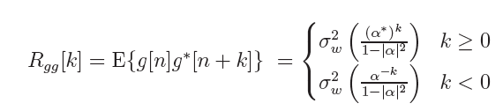
WSSUS AR channel model
Simple channel model to analyze
Similar to encountered situations

Slide 56



DFE: Notes
Same expected squared estimate error
Strong error dependence on FB channel offset
Cross term of separated offset is not necessarily diagonal

Slide 57
Acoustics Background
Acoustic wave is compression wave traveling through water medium

Slide 58
Time varying channel
Time variation is due to:
  Platform motion
  Internal waves
  Surface waves
Effects of time variability
  Doppler Shift
  Time dilation/compression of the received signal
Channel coherence times often << 1 second.
Channel quality can vary in < 1 second.

Slide 59
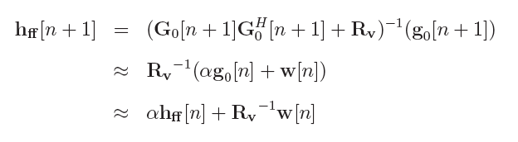

Low SNR Regime
Update eqn. for feed-forward equalizer coefficients (AR model assumed):
Approximation:
Has same correlation structure as channel coefficients

Slide 60


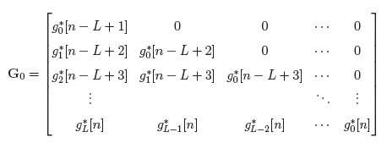
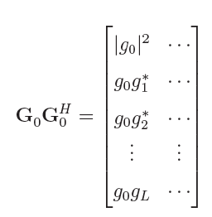

High SNR
Approximation:
Reduced Channel Convolution Matrix:
Matrix Product:
Reduces to single tap:

Slide 61
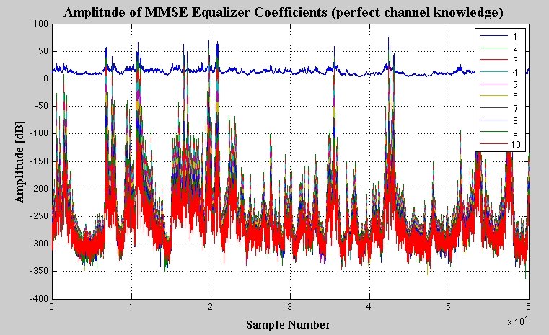
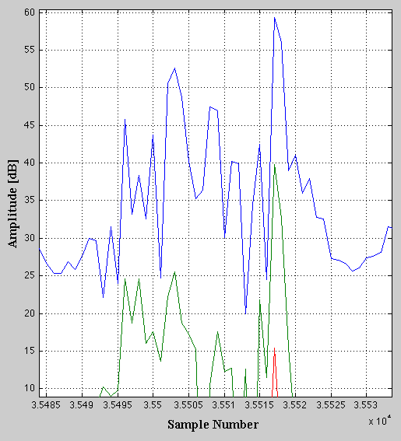
Amplitude of MMSE Eq. Coeff.
Tap #
20 dB difference
First feed-forward equalizer coefficient has much larger amplitude than others

Slide 62
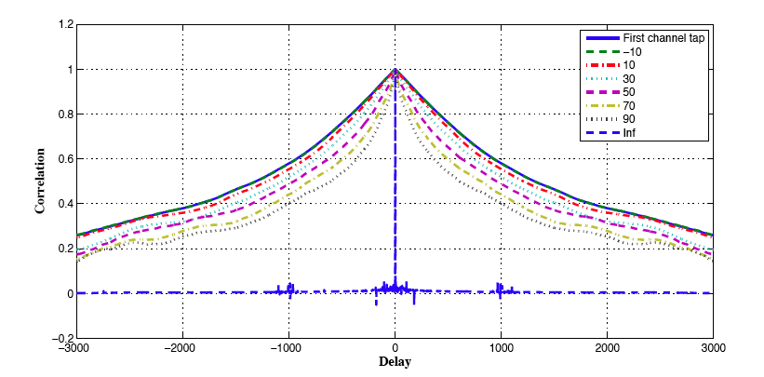
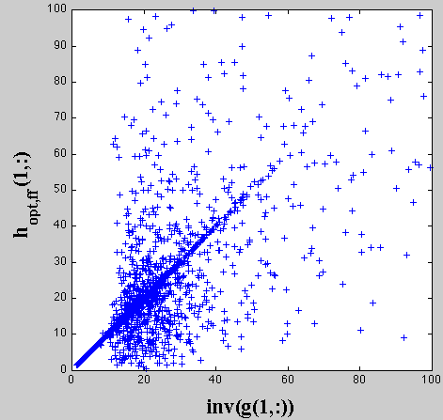
Multi-tap correlation
SNR
Multi-tap
AR(1)model
Strong linear correlation between inverse of first channel tap and first MMSE Eq. tap

Slide 63
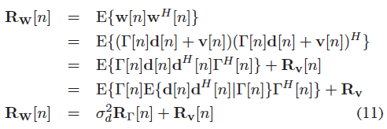
Form of observed noise correlation
Channel Estimation Model:
Data Model:
Effective Noise:
Effective Noise Correlation:

Slide 64



Algorithm to estimate effective noise
Calculate estimate of the effective noise:
Assume noise statistics slowly varying and calculate correlation of estimate noise vec.
RLS Update:

Slide 65
Additional Question:
How does channel length estimation effect equalization performance?

Slide 66
Recall DFE Equations
DFE Eq:
Vector of data RX data and TX data est.
Cost Function:
Solution to Weiner-Hopf Eq.
MMSE Sol. Using Channel Model

Slide 67



Channel Length Mismatch
Model: True channel is estimate + offset
Example: Static Channel
  True Channel length = 3
  Est. Channel Length = 2

Slide 68





DFE: Channel Estimation Errors
Split opt. DFE into estimate plus offset:
Form of equalizer (from estimated channel):
Form of equalizer offset:

Slide 69



DFE: Mean squared error analysis
Estimated DFE error:
Estimated expected squared error:
Estimated expected squared error (Channel Form):
Estimated expected squared error (Excess Error Form):
MAE
Excess Error

Slide 70






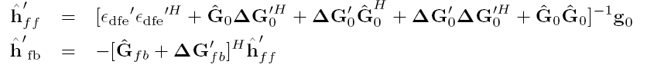
DFE: Offset Est. and Compensation
Estimate error vector (same as for LE)
Outer product w/ extended data vector
Subtract estimated channel offset
Split Estimated Channel offset into FB and other
Plug values into equalizer equation

Slide 71


Simulation:
DFE Time-Invariant Channel
Simulation Parameters:
True Channel Length = 7
Est. Channel Length = 6
Equalizer = DFE
L_{fb} = 5
Performance gap due to feedback path

Slide 72


Simulation:
DFE Rayleigh Fading Channel
Simulation Parameters:
True Channel Length = 4
Est. Channel Length = 3
Equalizer = DFE
L_{fb} = 3
Coherence time = 1s
Due to uncompensated channel motion “noise”
Performance gap appears due to channel time variability

Slide 73



Experimental Setup: RACE08
Experiment Signal Parameters:
12 kHz carrier
6510 ksym/s (~6 kHz bandwidth)
BPSK encoding
Used 1 receiving element (of 12)
39062.5 samples / second

Slide 74

Testing Setup: RACE08
Channel Est. Parameters:
  N_{a} = 2, N_{c} = 6
Equalizer = DFE
  L_{a} = 5, L_{c} = 3
Packet Length:
  25000 sym
RLS Parameters:
  λ=0.996
  N_{train} = 1000 sym
8 Samples

Slide 75


Experimental Results: RACE08
Direct Adaptation DFE = standard DA DFE
Chan. Est., Error Estimated DFE = Previous method
Chan Est., Biased Removed DFE = Proposed Method
Direct Adaptation
outperforms others
Proposed Method (Biased Removed)
outperforms error est. DFE

Slide 76
Take-home Message
Effect of channel length mismatch is proportional to energy in channel that is not modeled
DA equalization does not suffer from bad channel length information
  No way to include information in algorithm
Can recover some of the lost energy adaptively

